Slide 1
21CSC201J DATA STRUCTURES AND ALGORITHMS
Dijkstra’s Algorithm
UNIT 5

Slide 2
Dijkstra's algorithm
Dijkstra's algorithm - is a solution to the single-source shortest path problem in graph theory.
Works on both directed and undirected graphs. However, all edges must have nonnegative weights.
Input: Weighted graph G={E,V} and source vertex v∈V, such that all edge weights are nonnegative
Output: Lengths of shortest paths (or the shortest paths themselves) from a given source vertex v∈V to all other vertices

Slide 3
Dijkstra's algorithm
Procedure
It uses greedy technique.
It proceeds in stages.
It selects a vertex v, which has the smallest d_{v} among all the unknown vertices and declares the shortest path from s to v is known.
The remainder consists of updating the value of d_{w}.
We should d_{w} = d_{v} + C_{v, w}, if the new value for d_{w} would an improvement.
Dijkstra’s algorithm can be implemented using list with a time complexity of O(v2).
When a binary heap is used for implementation then time complexity can be reduced to O(E log V).

Slide 4
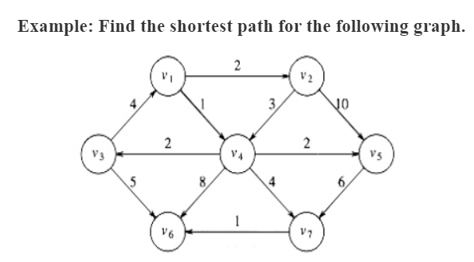
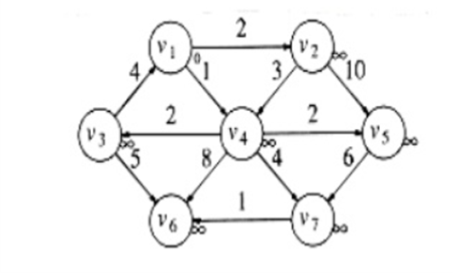
DIJKSTRA’S ALGORITHM- Example
V1 is taken as source
v | Known | d_{v} | p_{v}
V₁ | 1 | 0 | 0
V₂ | 0 | ∞ | 0
V₃ | 0 | ∞ | 0
V₄ | 0 | ∞ | 0
V₅ | 0 | ∞ | 0
V₆ | 0 | ∞ | 0
V₇ | 0 | ∞ | 0

Slide 5
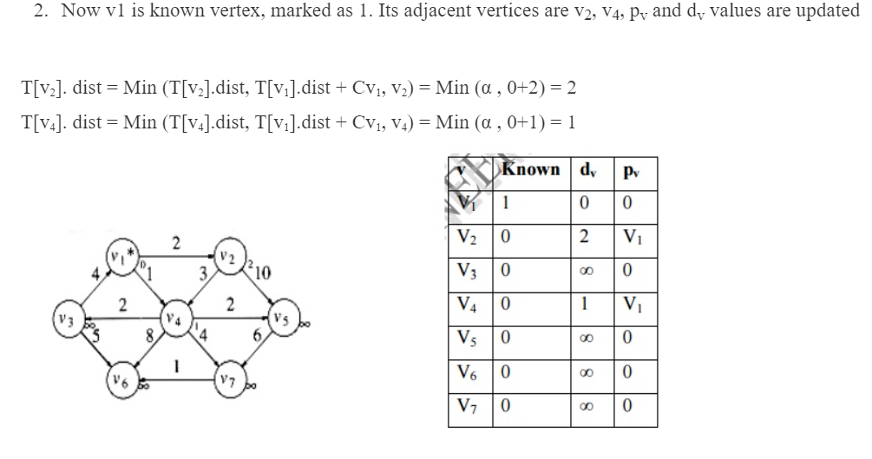
DIJKSTRA’S ALGORITHM-Example
2. Now V₁ is known vertex, marked as 1. Its adjacent vertices are v₂, v₄, p_{v} and d_{v}
values are updated.
T[v₂].dist = Min(T[v₂].dist,T[v₁].dist + Cv1, v2)=Min(α, 0+2)=2
T[v₄].dist = Min(T[v₄].dist,T[v₁].dist + Cv1, v2)=Min(α, 0+1)=1
v | Known | d_{v} | p_{v}
V₁ | 1 | 0 | 0
V₂ | 0 | 2 | V₁
V₃ | 0 | ∞ | 0
V₄ | 0 | 1 | V₁
V₅ | 0 | ∞ | 0
V₆ | 0 | ∞ | 0
V₇ | 0 | ∞ | 0

Slide 6
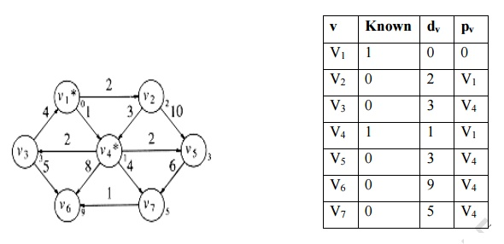
DIJKSTRA’S ALGORITHM- Example
3. Select the vertex with minimum distance away v₂ and v₄ . v₄ is marked as known vertex. Its adjacent vertices are v₃, v₅, v₆ and v₇ .
T[v₃]. dist = Min (T[v₃].dist, T[v₄].dist + Cv₄, v₃) = Min (α , 1+2) = 3
T[v₅]. dist = Min (T[v₅].dist, T[v₄].dist + Cv₄, v₅) = Min (α , 1+2) = 3
T[v₆]. dist = Min (T[v₆].dist, T[v₄].dist + Cv₄, v₆) = Min (α , 1+8) = 9
T[v₇]. dist = Min (T[v₇].dist, T[v₄].dist + Cv₄, v₇) = Min (α , 1+4) = 5

Slide 7
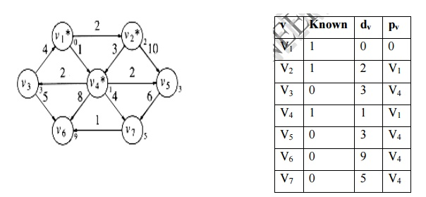
DIJKSTRA’S ALGORITHM- Example
4. Select the vertex which is shortest distance from source v₁. v₂ is smallest one. v₂ is marked as known vertex. Its adjacent vertices are v₄ ad v₅. The distance from v₁ to v₄ and v₅ through v₂ is more comparing with previous value of d_{v}. No change in d_{v} and p_{v} value.
v | Known | d_{v} | p_{v}
V₁ | 1 | 0 | 0
V₂ | 1 | 2 | V₁
V₃ | 0 | 3 | V₄
V₄ | 1 | 1 | V₁
V₅ | 0 | 3 | V₄
V₆ | 0 | 9 | V₄
V₇ | 0 | 5 | V₄

Slide 8
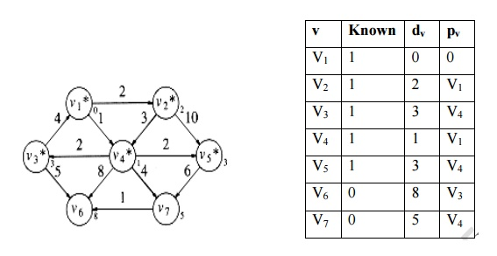
DIJKSTRA’S ALGORITHM- Example
5. Select the smallest vertex from source. v₃ and v₅ are smallest one. Adjacent vertices for v₃ is v₁ and v₆. v₁ is source
there is no change in dv and pv
T[v₆]. dist = Min (T[v₆].dist, T[v₃].dist + Cv₃, v₆) = Min (9 , 3+5) = 8
d_{v} and p_{v} values are updated. Adjacent vertices for v₅ is v₇. No change in d_{v} and p_{v} value.

Slide 9
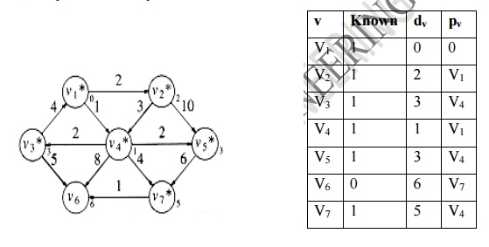
DIJKSTRA’S ALGORITHM- Example
6. Next smallest vertex v₇. Its adjacent vertex is v₆. T[v₆]. dist = Min (T[v₆].dist, T[v₇].dist + Cv₇, v₆) = Min (8 , 5+1) = 6
d_{v} and p_{v} values are updated.
v | Known | d_{v} | p_{v}
V₁ | 1 | 0 | 0
V₂ | 1 | 2 | V₁
V₃ | 1 | 3 | V₄
V₄ | 1 | 1 | V₁
V₅ | 1 | 3 | V₄
V₆ | 0 | 6 | V₇
V₇ | 1 | 5 | V₄

Slide 10
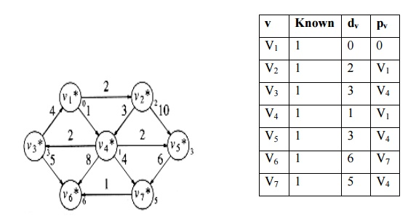
DIJKSTRA’S ALGORITHM- Example
7. The last vertex v₆ is declared as known. No adjacent vertices for v₆. No updation in the table.
The shortest distance from source v₁ to all vertices. v₁ -> v₂ = 2
v₁ -> v₃ = 3 v₁ -> v₄ = 1 v₁ -> v₅ = 3 v₁ -> v₆ = 6 v₁ -> v₇ = 5
Algorithm Analysis
Time complexity of this algorithm
O(|E| + |V|² ) = O(|V|² )

Slide 11
Routine for prim’s Algorithm
void Dijkstra(Table T)
{
Vertex v, w; for( ; ;)
{
v = smallest unknown distance vertex;
if( v = = NotAVertex) break;
T[v]. kown = True;
for each w adjacent to v if(!T[w].known)
if(T[v].Dist + C_{vw} < T[w]. Dist)
{/* update w*/
Decrease(T[w]. Dist to T[v].Dist + C_{vw);}
T[w]. path = v;
} } }

Slide 12
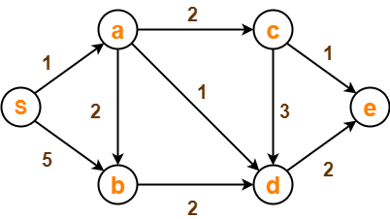
Exercise
Using Dijkstra’s Algorithm, find the shortest distance from source vertex ‘S’ to remaining vertices in the following graph

Slide 13
Review Questions
Dijkstra’s Algorithm is used to solve _____________ problems.
___________is the most commonly used data structure for implementing Dijkstra’s Algorithm.
__________ is the time complexity of Dijkstra's algorithm.
Dijkstra’s Algorithm cannot be applied on ______________ graph.
Dijkstra’s Algorithm is based on _______________ approach.

Slide 14
Thank you

